Slide 1





Evi-match app
Web app
Graph ql
Apollo client
Hot chocolate – A graph QL server for.NET CORE
Graph ql API

Slide 2
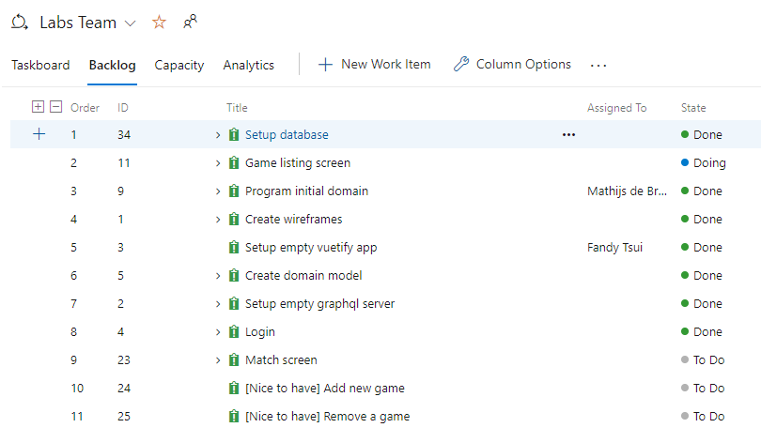
What did we build in 2 days?

Slide 3
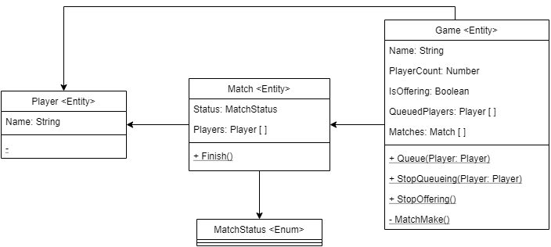
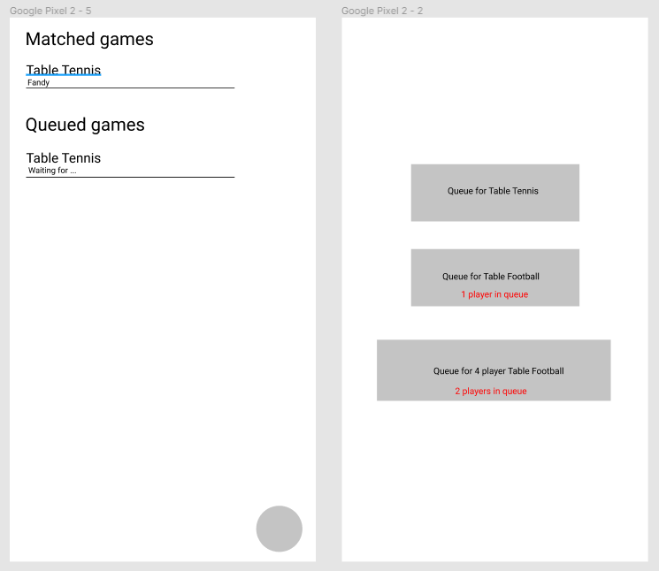
Evi match app
An app to match you with other players for games like ping-pong, table football and more…
Notes:
Then show app & introduce features:
Login with evident account
View list of matched games & queued games
list of unqueued games
Add game
Remove game?

Slide 4
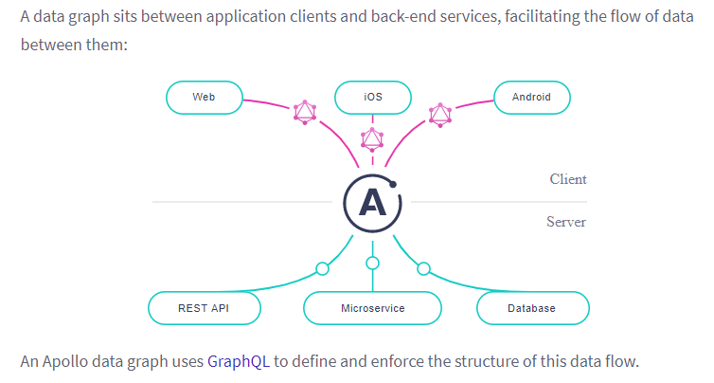
What is Apollo?
GraphQL query
Updates UI
Client normalizes & stores data
Request data
Send results
Source: https://www.apollographql.com/docs/intro/platform/
Notes:
The Apollo platform helps you build, query, and manage a data graph: a unified data layer that enables applications to interact with data from any combination of connected data stores and external APIs.
- Apollo Server (node JS), Apollo Client

Slide 5
What is Apollo Client?
“You can cache subsets of your backend data graph on the client-side and work with it the same way you’d work with global state using tools like Redux or React Context (or Vuex). This means Apollo Client is also a state management library and a data-fetching tool.”
Source: https://www.apollographql.com/blog/introducing-the-apollo-client-best-practices-series/
Notes:
Query – saves new data objects in the cache
Mutation – update single item in the cache & trigger re-render to the UI automatically, or access data object to add or delete item in the cache

Slide 6
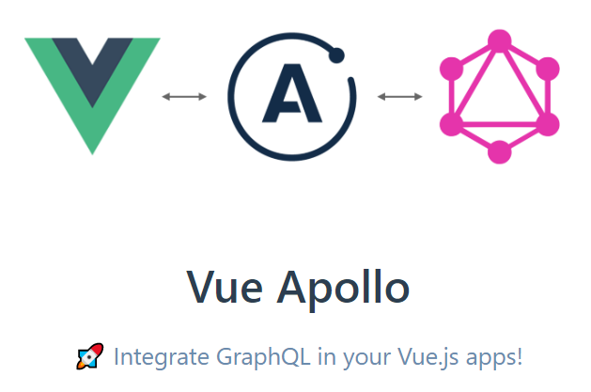
Set up Vue Apollo Client:
npm packages:
vue-apollo
graphql
apollo-client
apollo-link-http
apollo-cache-inmemory
graphql-tag
VS code extension:
Apollo GraphQL
How to set up intelligent autocomplete:
https://marketplace.visualstudio.com/items?itemName=apollographql.vscode-apollo
https://www.apollographql.com/docs/devtools/editor-plugins/
Google chrome extension:
Apollo Client Developer Tools

Slide 7


Slide 8
Queries – Hot Chocolate
Field bindings
Filtering / Sorting
Authentication

Slide 9
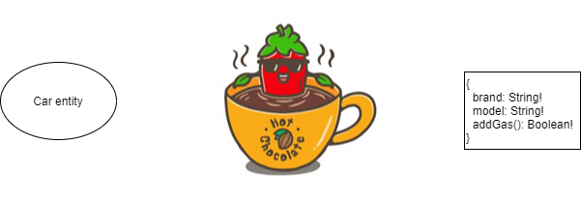
Queries – Field bindings
By default, all entity fields are added to the schema

Slide 10
Mutation
Code example

Slide 11
Caching
Caching in Apollo
fetchPolicies

Slide 12
Where are the subscriptions?

Slide 13
Closing
Where to find the repo?
https://dev.azure.com/evi-azure-practice/Labs/_git/TechRadar_GraphQL_Reference
Everyone can contribute to this project
Infrastructure – Pulumi, Farmer
Frontend framework – Vue 3
Styling – CSS modules
Code quality – SonarQube
Configuration – Azure App Configuration

Slide 14
Sources
https://apollo.vuejs.org/
https://www.apollographql.com/docs/
https://hotchocolate.io/
https://marketplace.visualstudio.com/items?itemName=apollographql.vscode-apollo
https://graphql.org/

